Slide 1
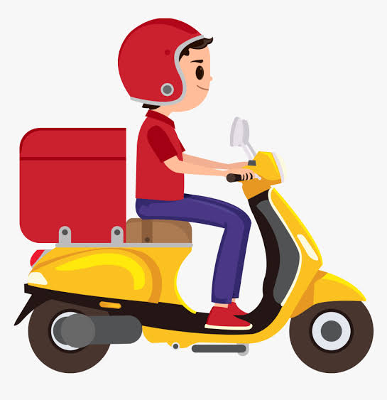
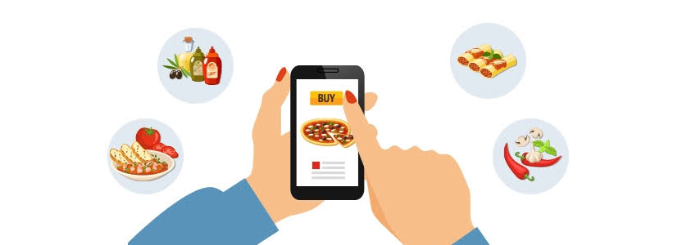

ONLINE FOOD DELIVERY SYSTEM
RLL PROJECT

Slide 2
230 Java SL AB -RLL -Group 9
NAME OF THE DEVELOPER
EMPLOYEE ID
HARSH SHARMA[Team Leader]
2564318
SAIYOGESH H
2564341
SANCHAI VALAN RAJ
2563381
VINAYAKA SANJANA
2563930
SHASHI SHEKHAR
DEEPAK X
2563105
2563490
D SAKTHIVEL
2563069

Slide 3
ABSTRACT
In this project, we have created a full-stack web application called Online Food Delivery Application.
In this Application we can Order food items of different cuisines from a restaurant
We have used spring-boot for the backend, angular for the frontend, and MySQL for the database.
In this, users can signup/login and order food through online .
Admin can log in and do all the crud operations on products, customers, and purchases.
Cashless Transactions can be Made

Slide 4
OBJECTIVE
To provide a bug-free Online Food Delivery system to Users as well as Admin.
The main objective is here to provide a nice and secure platform for Ordering Food.
To maintain the records of Product, Category available into the system.

Slide 5
INTRODUCTION
Online ordering system that we are proposing here, greatly simplifies the ordering process for both the customer and the restaurant. System presents an interactive and up to-date menu with all available options in an easy to use manner.
Customer can choose one or more items to place an order which will land in the Cart. Customer can view all the order details in the cart before checking out. At the end, customer gets order confirmation details. Once the order is placed it is entered in the database and retrieved in pretty much real time.
This allows Restaurant Employees to quickly go through the orders as they are received and process all orders efficiently and effectively with minimal delays and confusion.

Slide 6
USER FUNCTIONALITIES
Register to the application
Change password
Update Profile
Sign into the application to maintain the record of activities
Search for food items based on the search keyword
Apply filters and sort results based on different cuisines to get the best deals
Add all the selected food items to a cart and customize the purchase at the end
Perform a seamless payment process

Slide 7
TOOLS AND TECHNOLOGIES
Front-End: Angular
Server-side: Spring Boot.
Back-end: MYSQL, Hibernate.
Server: Tomcat
Testing: Junit and Post Man Testing.

Slide 8
ANGULAR
Angular is a TypeScript-based free and open-source web application framework lead by the Angular Team at google and by a community of individuals and corporations. Angular is a complete rewrite from the same team that built Angular js.
Angular is a JavaScript (actually a TypeScript based open-source full-stack web application) framework which makes you able to create reactive Single Page Applications (SPAs). Angular is completely based on components. It consists of several components which forms a tree structure with parent and child components.
SPA- A single page application is a web application or a website which provides users a very fluid, reactive and fast experience similar to a desktop application. It contains menu, buttons and blocks on a single page and when a user clicks on any of them; it dynamically rewrites the current page rather than loading entire new pages from a server. That's the reason behind its reactive fast speed.

Slide 9
FEATURES OF ANGULAR
Cross-platform
Efficient MVC architecture
Data binding
Set of Directives
Prominence of TypeScript
Declarative UI
Extensive documentation and support
Timely upgradations

Slide 10
COMPONENTS BUILT USING ANGULAR
Admin login
Admin dashboard
Manage customer
Manage purchase
Home
Header
Product
Cart
Payment gateway
Order summary

Slide 11
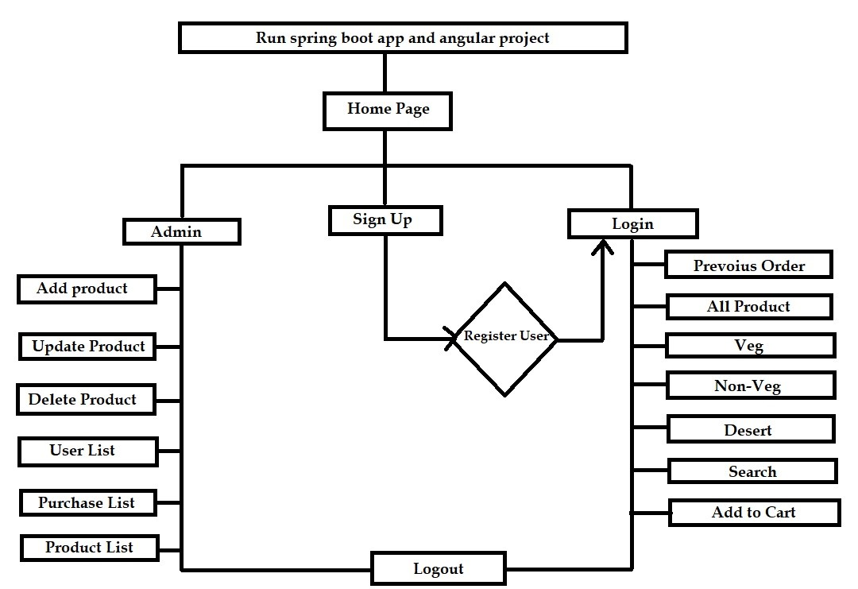
FLOWCHART

Slide 12
ADMIN FUNCTIONALITIES
CREATE ADMIN ACCOUNT
ADD OR REMOVE DISH
EDIT DISH
DISABLE DISH
LOGIN
Login to portal
Create Admin Account
Add or remove cuisines to or from the application to build a rich product line
Edit food item details like name, price, cuisine, description, and offers to keep it aligned to current prices.
Enable or disable food items

Slide 13
Admin.java
In an online food delivery system, Admin.java likely represents a Java class that defines the attributes and methods related to an admin user. This class may store information such as admin ID, username, password, and permissions.
AdminController.java
AdminController.java is probably a controller class responsible for handling interactions and logic related to admin functionalities. It might include methods for managing restaurant listings, user accounts, orders, and other administrative tasks.
Admin Repository.java
The Admin Repository.java could be a part of the system's backend that manages the storage and retrieval of admin-related data from a database. It would likely contain methods for CRUD (Create, Read, Update, Delete) operations on admin entities.

Slide 14
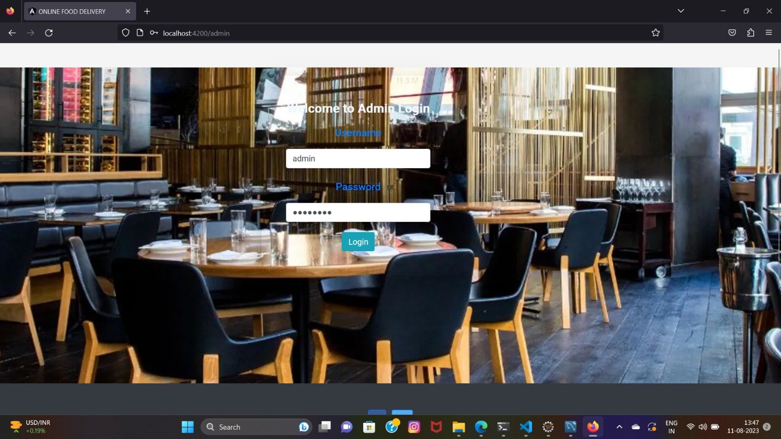

Slide 15
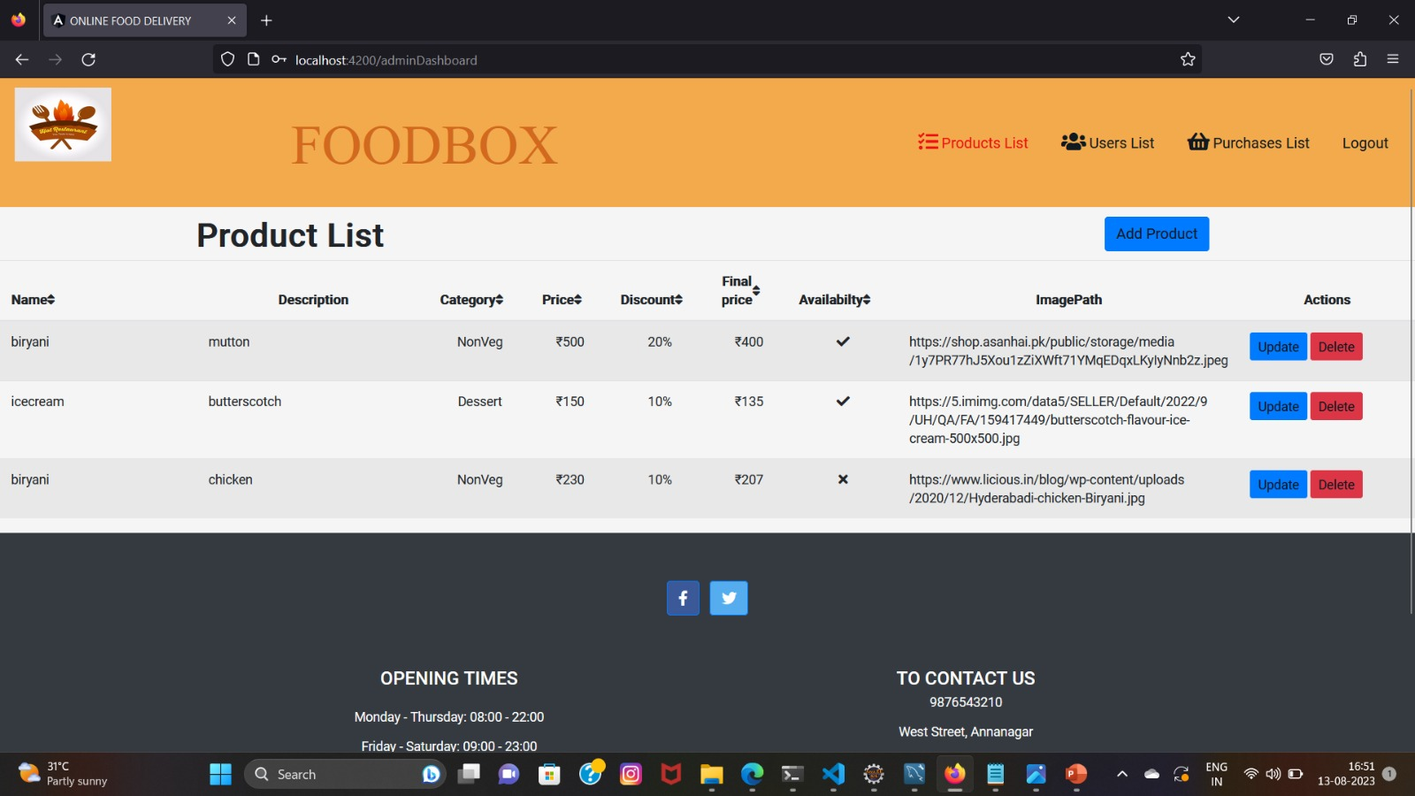

Slide 16
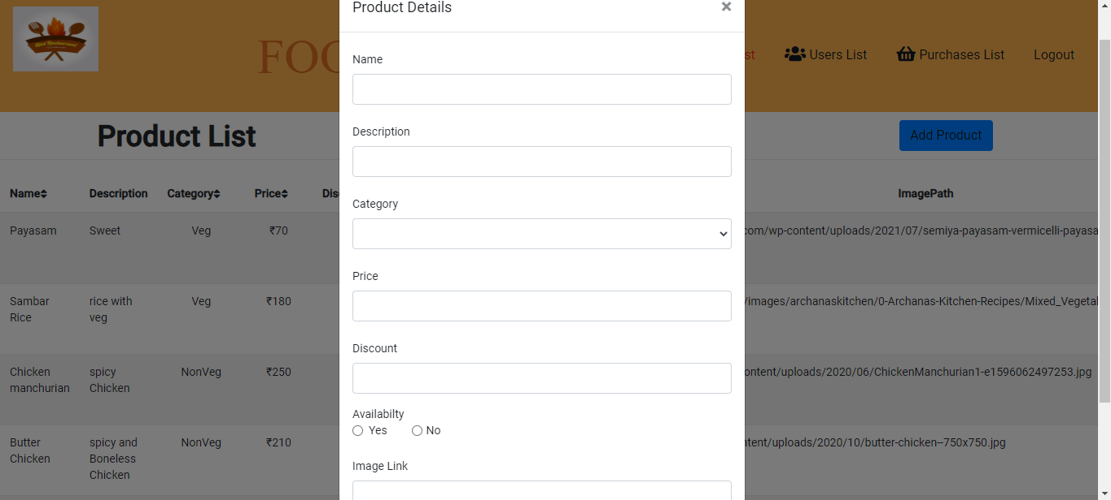

Slide 17
Manage Customers
In an online food delivery system website managing customers involves tasks such as user registration, profile management, order history tracking, and personalized recommendations.
Efficient customer management enhances user experience, builds trust, and promotes repeat business on the platform.

Slide 18
ManageCustomer.java
It is likely be a Java class responsible for handling customer-related operations, such as creating, updating, and deleting customer accounts, as well as managing their orders and preferences.
ManageCustomerComponent.java
It could be a component class that encapsulates various functionalities related to customer management. It provide methods to interact with the ManageCustomer.java class and could handle tasks like authentication, authorization, and validation for customer actions.
ManageCustomerRepository.java
An interface or class responsible for database operations related to customers. It would define methods for retrieving, storing, and manipulating customer data in the system's database. This component ensures proper data management and storage for customer-related information.

Slide 19
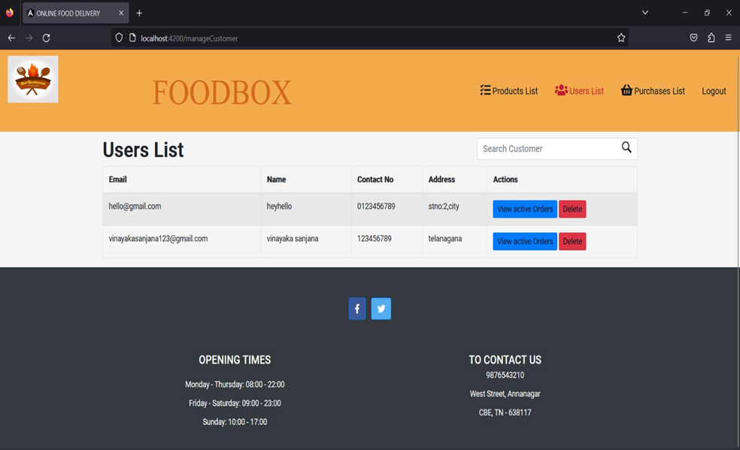

Slide 20
Manage Purchase
In an online food delivery system website managing purchases involves overseeing the entire process of ordering and paying for food.
This includes displaying menus, enabling users to select items, adding them to a cart, specifying delivery details, and processing payments securely.
The system must also track orders, update users about their order status, and handle any modifications or cancellations.
Effective purchase management ensures a seamless experience for customers and efficient operations for the food delivery platform.

Slide 21
ManagePurchase.java:
This Java class serves as a central hub for managing purchase-related functionalities. It will handle tasks such as processing new orders, calculating costs, applying discounts, and ensuring accurate delivery details. By encapsulating these functions, it helps maintain a clean and organized codebase while facilitating smooth order processing.
ManagePurchaseComponent.java:
This component could be part of a larger software architecture, such as a Spring-based application. It provide dependency injection and configuration for the purchase-related functionalities. By separating concerns and promoting modularity, this component contributes to a more maintainable and scalable system, allowing different parts of the application to interact seamlessly.
ManagePurchaseRepository.java:
This component represents the interface between the application and the data storage layer. It handles tasks such as storing and retrieving purchase-related data, order history, payment details, and customer information.

Slide 22
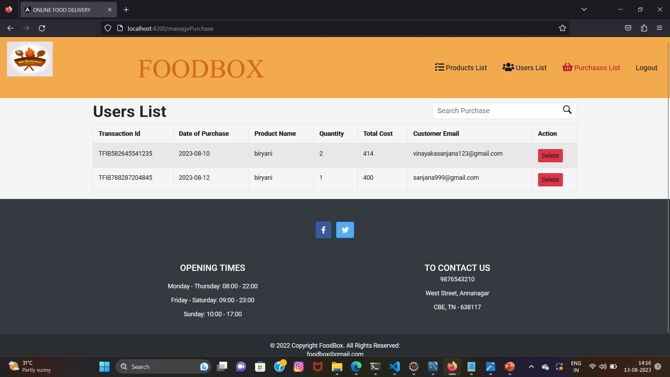

Slide 23
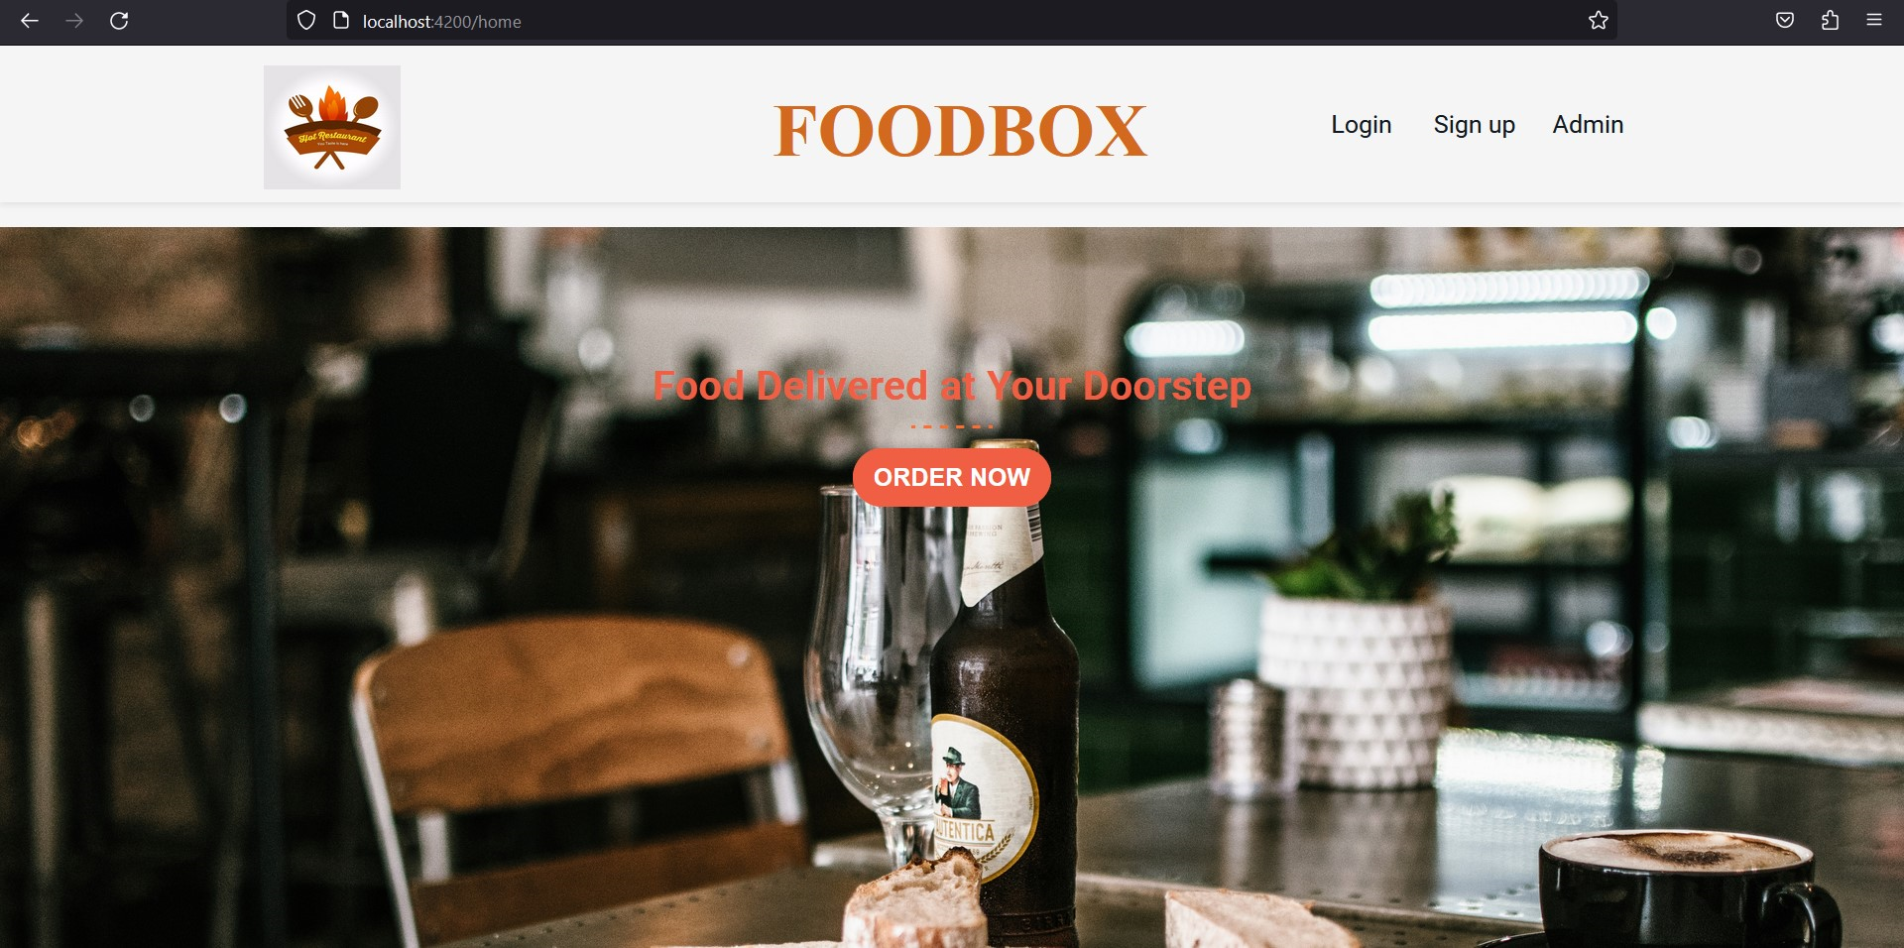
Home
The home page in the application. It would contain the layout, design, and interactive elements that users see when they first open the app. It might display featured restaurants, search options, and other key components to help users navigate the platform.

Slide 24
Header:
The header is a key interface element located at the top of the website or app. It typically contains navigation links, a logo, and user-related options like login, signup, or account settings. In the context of an online food delivery system, the header would allow users to easily navigate to different sections of the platform, such as exploring restaurants, accessing their cart, managing their profile, or searching for specific food items.
.

Slide 25
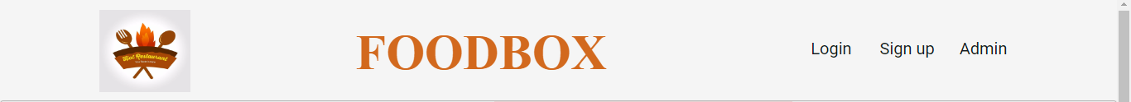

Slide 26
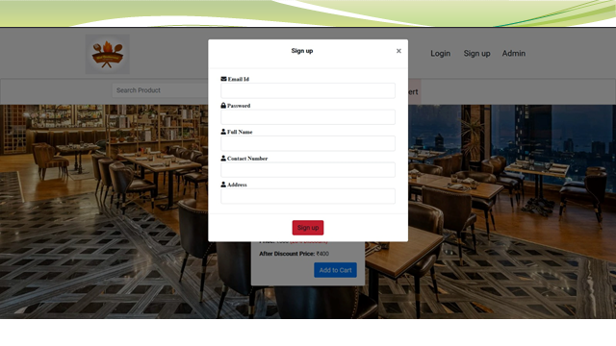

Slide 27
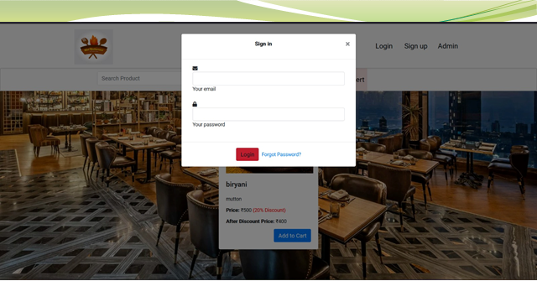

Slide 28
Forgot Password
The "Forgot Password" feature on an online food delivery website allows users who have forgotten their login credentials to reset their password.
When users click on this option, they typically receive a password reset link via email or SMS.
This link directs them to a secure page where they can enter a new password.
This process ensures that users can regain access to their accounts and continue using the food delivery service without creating a new account.

Slide 29
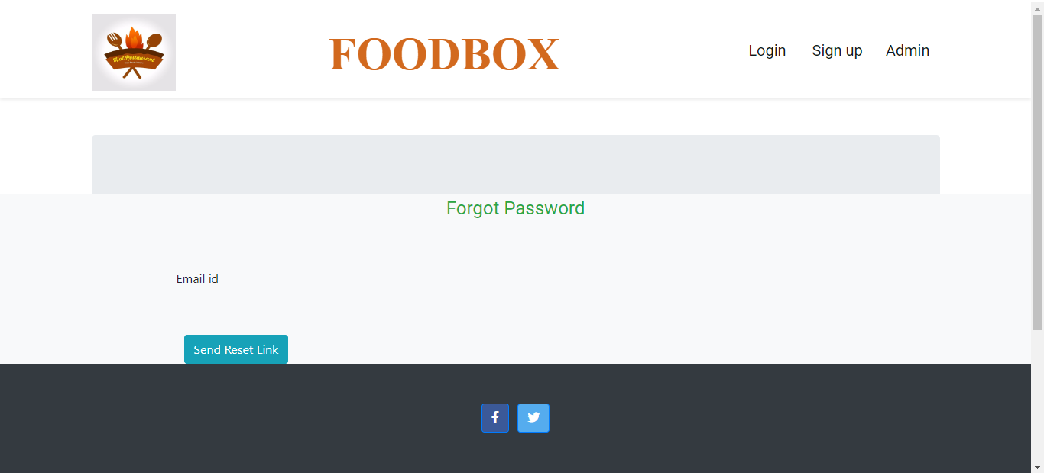

Slide 30
Product.java:
This class likely represents individual food items or products available for purchase on the platform. It may contain attributes like a unique identifier, name, description, price, image, and possibly other relevant information.
ProductComponent.java:
This class is used to model different components or ingredients that make up a product. It could be part of a more complex product structure, allowing customization of food items based on user preferences. For example, if a user can build their own burger, this class might define components like patty, bun, cheese, etc.
ProductRepository.java:
This class could serve as a repository or storage for managing and accessing product data. It might handle operations such as adding, updating, deleting, and retrieving product information from a database or data store. This is an important component for the system to efficiently manage and display the available food items to users.

Slide 31
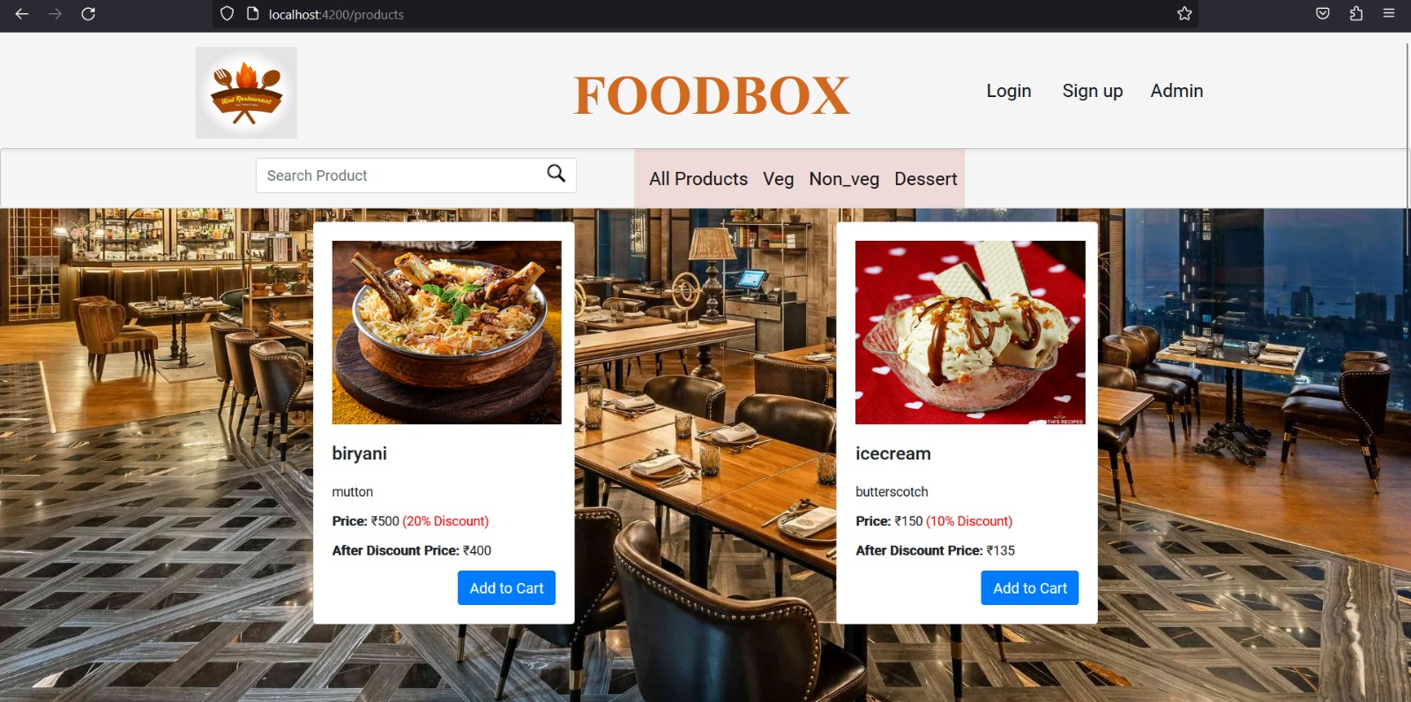

Slide 32
Cart:
The cart is a virtual representation of the user's selected items for purchase. In online food delivery, the cart enables users to add food items they wish to order. It displays the names, quantities, and often prices of the selected items. Users can review their cart before proceeding to checkout, make modifications such as adding or removing items, and see an estimated total cost

Slide 33
Cart.java
Cart.java is likely a Java class that represents the concept of a user's shopping cart in an online food delivery system. This class would typically contain attributes and methods related to managing the items a user has selected for purchase. It might store information such as the items in the cart, their quantities, prices, and any customizations. The class could also include methods to add, remove, or modify items in the cart.

Slide 34
CartController.java
CartController.java is probably a Java class that acts as a controller in the backend of the online food delivery system. Its role is to handle interactions related to the cart functionality. This includes receiving requests from the user interface, processing them, and communicating with the CartRepository (or database) to retrieve or update cart-related data. The controller might include methods to add items to the cart, update quantities, remove items, and handle other cart-related actions.
CartRepository.java:
The CartRepository.java is likely a component responsible for managing the storage and retrieval of cart-related data in a database or other data storage system. It provides an abstraction layer for interacting with the underlying data storage, allowing the application to perform CRUD (Create, Read, Update, Delete) operations on cart-related information

Slide 35
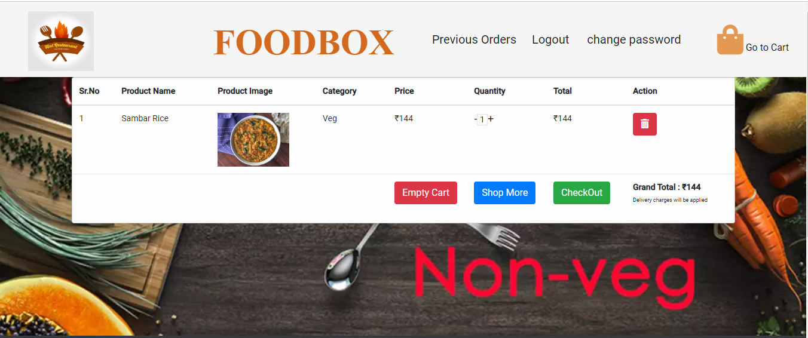

Slide 36
Order Summary
In an online food delivery system, an order summary provides a concise overview of a customer's selected items and their details before finalizing the purchase.
It typically includes information such as the names of the dishes, quantities, prices, any applied discounts , subtotal, Transaction id, delivery fees, and the grand total.
This summary allows users to review their order before proceeding to payment, ensuring accuracy and transparency in the transaction process.

Slide 37
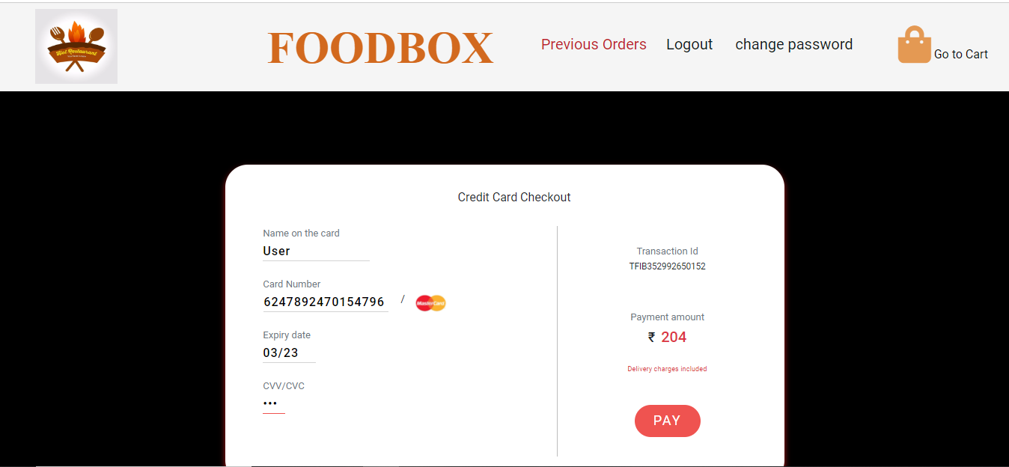

Slide 38
Payment Gateway
An payment gateway is a vital component of an online food delivery system website.
It serves as a secure bridge between the customer and the restaurant, facilitating the electronic transfer of funds for orders.
When a customer places an order, the payment gateway encrypts sensitive payment information, such as credit card details, to ensure confidentiality.
It processes the payment, verifies its authenticity, and notifies the website about the successful transaction. This seamless process ensures that customers can pay for their orders conveniently while maintaining the security of their financial data.

Slide 39
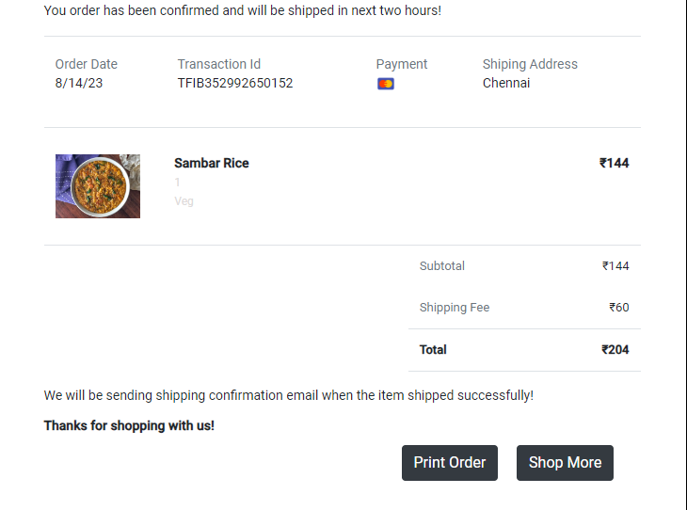

Slide 40
MODEL
In an online food delivery system, the model consists of several TypeScript files representing different components:
admin.ts: This file likely handles administrative functionalities, such as managing restaurants, menus, and orders.
cart.ts: The cart.ts file probably manages the shopping cart functionality, allowing customers to add and remove items before placing an order.
customer.ts: This file likely represents the customer model, storing information about customers such as their profiles, preferences, and order history.
product.ts: The product.ts file probably defines the product model, including details about food items available for ordering, such as name, description, price, and possibly images.
purchase.ts: This file might deal with purchase-related information, tracking orders, payment details, and order status for both customers and the system.

Slide 41
REST API

Slide 42
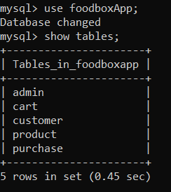
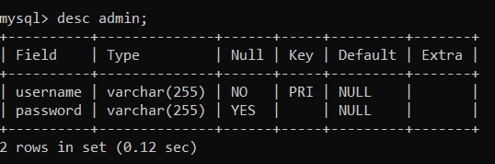
DATABASE TABLES

Slide 43
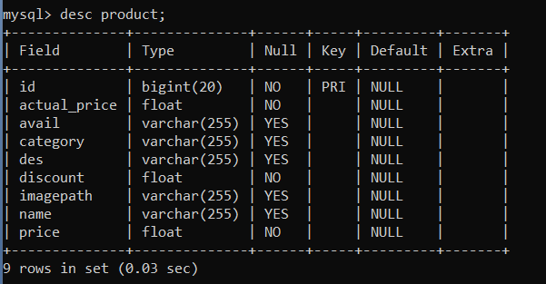
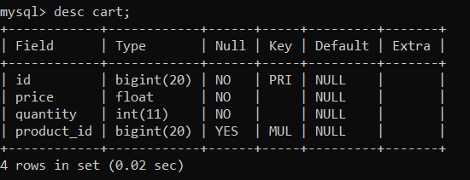
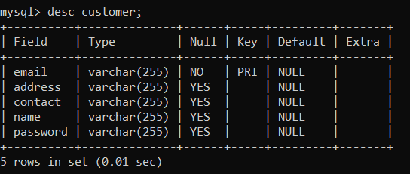
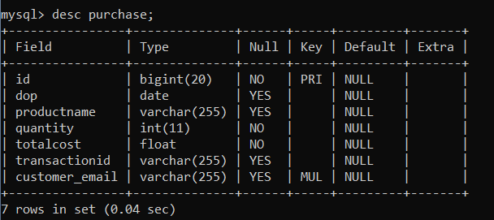

Slide 44
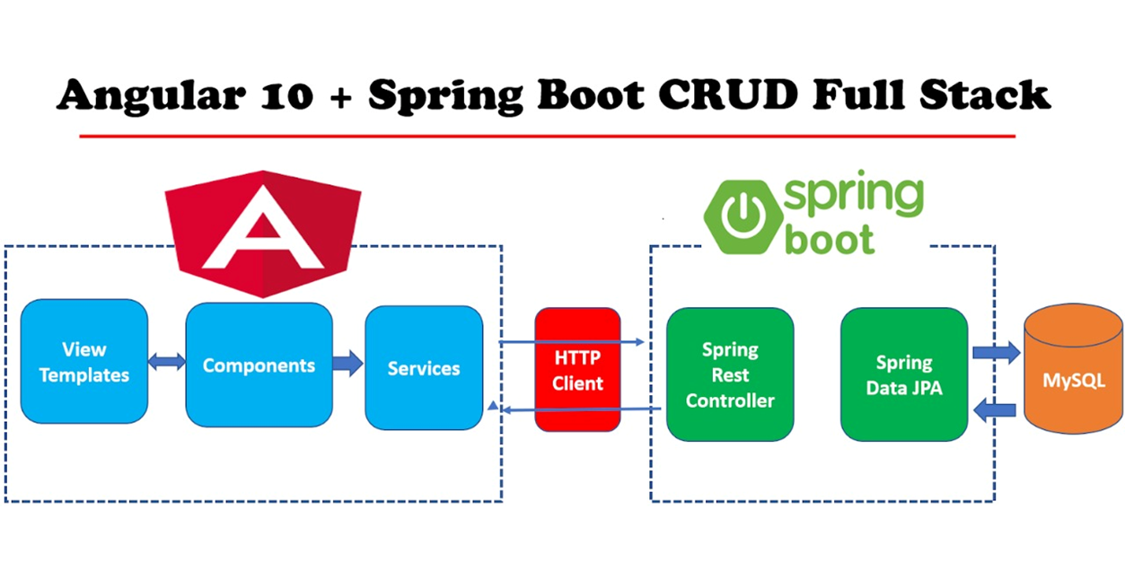
SERVER CONNECTVITY

Slide 45
INTEGRATION
MySQL database is connected to the backend application.properties file.
Backend is connected to frontend through the service.ts files.
The service.ts files are used to connect the backend and frontend.The httpclient url of the backend is added here for inclusion in service.ts files.
class AdminService {
private baseURL="http://localhost:8080/admin"
constructor(private httpClient:HttpClient) { }
In a similar manner, cross origin annotation links the frontend and the backend.
Using @CrossOrigin(origins = "http://localhost:4200")

Slide 46
APPLICATION.PROPERTIES
spring.datasource.driver-class-name = com.mysql.jdbc.Driver
spring.datasource.url=jdbc:mysql://localhost:3306/foodbox
spring.datasource.username=root
spring.datasource.password=root
spring.jpa.properties.hibernate.dialect org.hibernate.dialect.MySQL5InnoDBDialect
spring.jpa.hibernate.ddl-auto = update

Slide 47
TESTING IN SPRING BOOT
Testing is a process that ensures the software functions without errors and fulfils the standards established by the required specification.
Spring Boot provides a variety of tools and annotations to make it simpler to test your application.
The tests are provided by two modules: spring-boot-test-autoconfigure provides test auto-configuration, and spring-boot-test contains the necessary components.

Slide 48
TYPES OF TESTING
There are two different methods of testing for our SprinGBootproject.
1.Perform Unit Testing using Junit frameworks
2.Post Man Testing

Slide 49
JUNIT TESTING
The JUnit framework can be used to call a method and confirm (or assert) that the result is what you anticipated.
An annotation named @Test, which is derived from JUnit Dependency, is required for unit testing.
JUnit is a Java testing framework that makes writing reliable and efficient tests easy. It can be used for applications made in most languages but is particularly suited for testing Java applications. JUnit can also be used to create automated tests.
JUnit framework is one of the most popular Java testing frameworks. It offers several features that make writing tests easy, including support for multiple test cases, assertions, and reporting. JUnit is also versatile, allowing tests to be written in various languages.

Slide 50
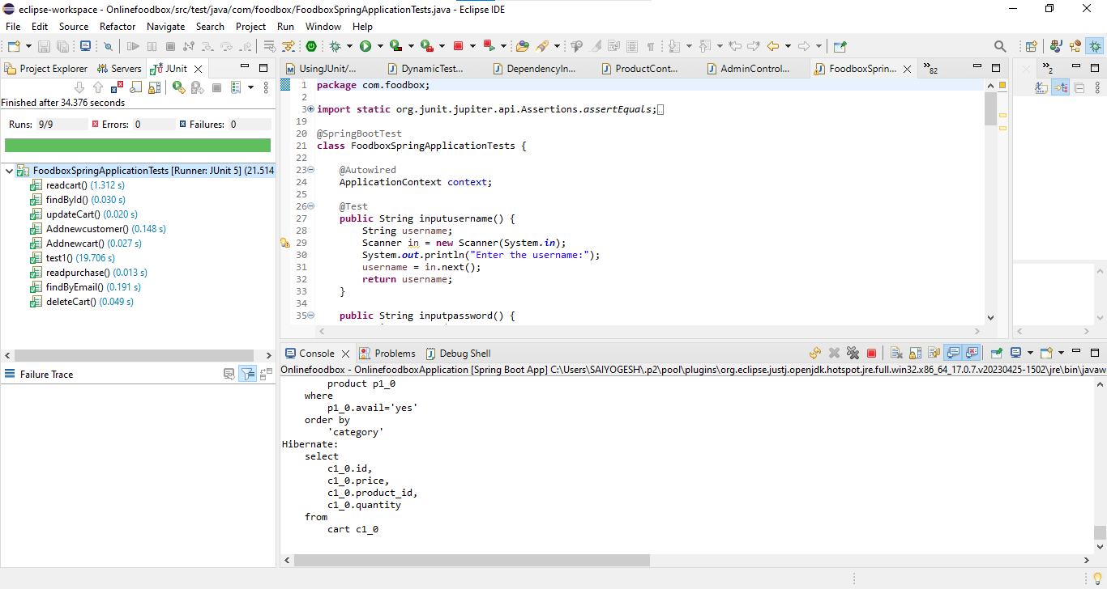

Slide 51
POST-MAN TESTING
Postman is an application used for API testing. It is an HTTP client that tests HTTP requests, utilizing a graphical user interface, through which we obtain different types of responses that need to be subsequently validated.
It is a tool for testing the software of an API. It can be used to design, document, verify, create, and change APIs. Postman has the feature of sending and observing the Hypertext Transfer Protocol (HTTP) requests and responses

Slide 52
POST-MAN TESTING URL
http://localhost:8080/carts --(Get method)
http://localhost:8080/products/cust --(Get method)
http://localhost:8080/products/{id} --(Get method)
http://localhost:8080/products/{keyword} --(Get method)
http://localhost:8080/products/{id}--(Put method)
http://localhost:8080/products/{id} --(Delete method)
http://localhost:8080/products --(Post Method)
http://localhost:8080/customers --(Get method)

Slide 53
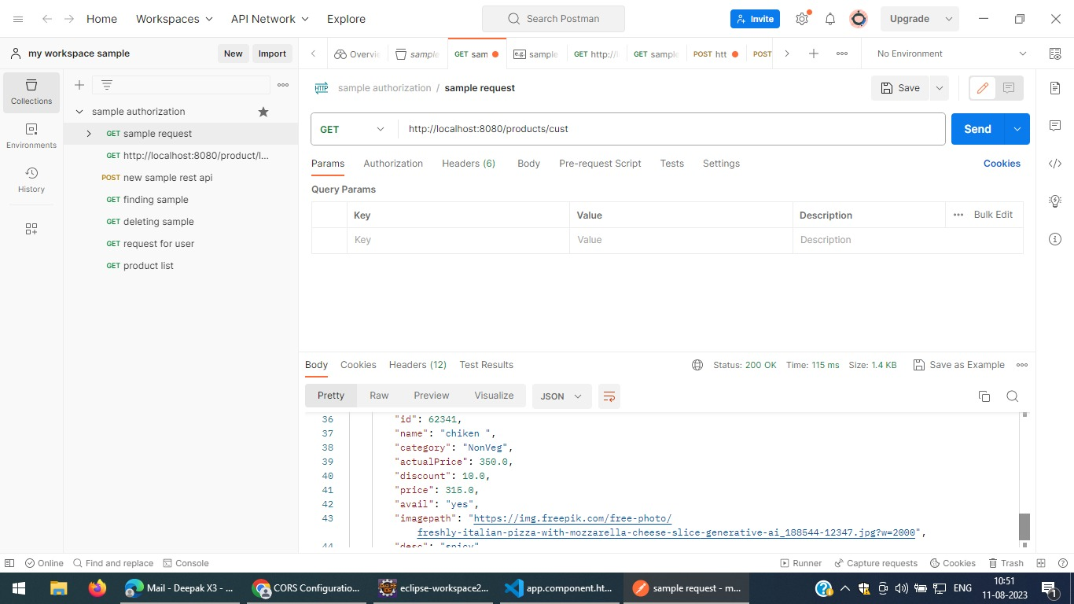
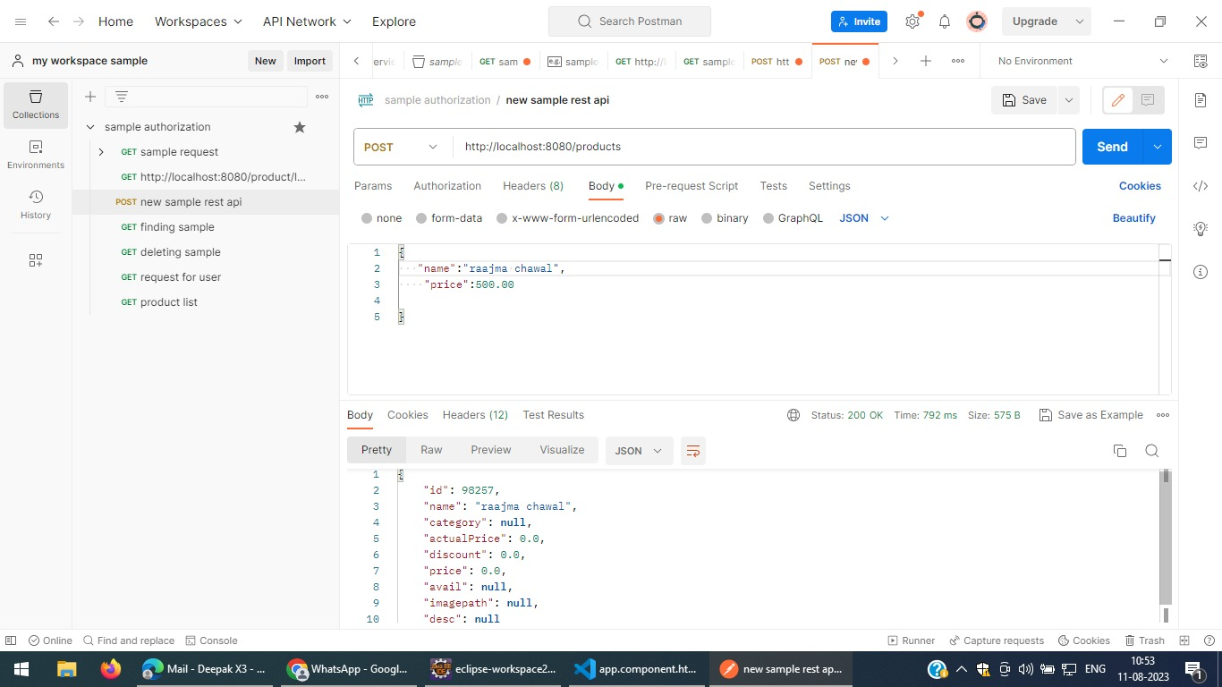

Slide 54
CONCLUSION
Finally, for the online meal ordering system, we created a secure, user-friendly food ordering administration system.
Whether they are Administrators or Customers, this system can look after them all.
This system will let them manage client meals, delivery boy data, and expand without creating any disruption.
This system is completely secure because each user is assigned a unique user ID and password, preventing Un authorised access.
It is significantly simpler to use with online registration, payment, and cancellation.
As a result, employing this method will reduce labor costs while increasing the amount of time clients can spend taking use of the services.

Slide 55
THANK YOU

